Slide 1
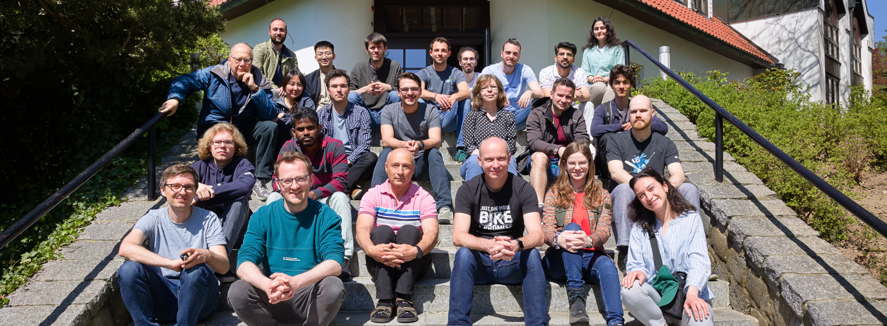
Tiny CNN with microfluidic pipes
Jorge Torres Gómez | Telecommunication Networks

Slide 2
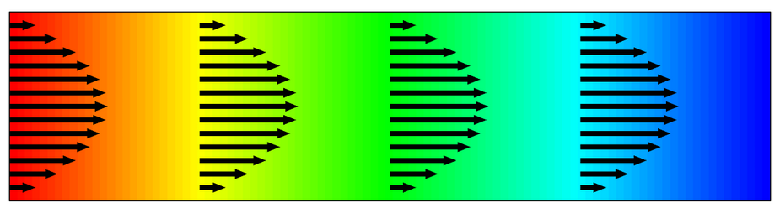

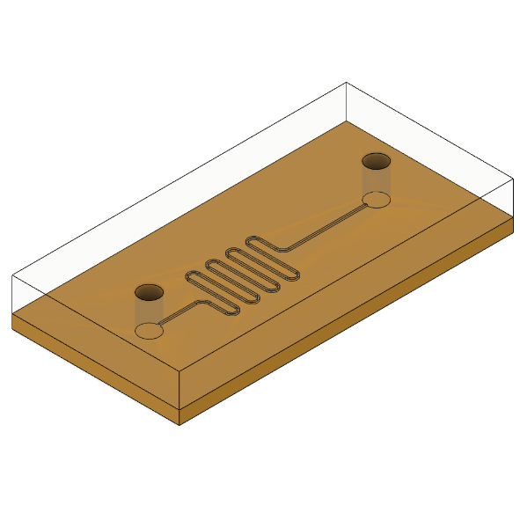
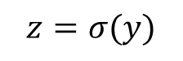
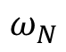
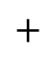
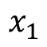

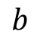
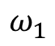
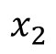
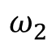
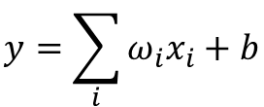
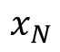
Bio-Computing
Single Neuron Scheme
Digital Computing
Chemical Reaction Networks
DSP
Microfluidic Chips
$$b$$
Activation
Function
$$x_{1}$$
$$ω_{N}$$
$$y=\sum_{i}{ω_{i}x_{i}}+b$$
$$x_{2}$$
$$ω_{2}$$
$$+$$
$$z=σ(y)$$
$$⋯$$
$$x_{N}$$
$$ω_{1}$$
Transport of Diluted Species
Chemical
Reaction
[1] A. O. Bicen and I. F. Akyildiz, “System-Theoretic Analysis and Least-Squares Design of Microfluidic Channels for Flow-Induced Molecular Communication,” IEEE Transactions on Signal Processing, vol. 61, no. 20, pp. 5000–5013, Oct. 2013, doi: 10.1109/TSP.2013.2274959.
Microfluidic Circuit
2

Slide 3
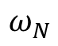
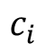
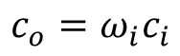
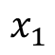
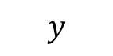
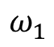
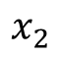
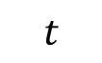
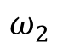
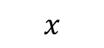
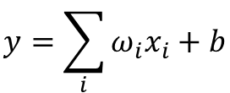
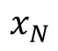
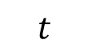
Concept
Single Neuron Scheme
Digital Computing
Chemical Reaction Networks
DSP
Microfluidic Chips
$$b$$
Activation
Function
$$x_{1}$$
$$ω_{N}$$
$$y=\sum_{i}{ω_{i}x_{i}}+b$$
$$x_{2}$$
$$ω_{2}$$
$$+$$
$$z=σ(y)$$
$$⋯$$
$$x_{N}$$
$$ω_{1}$$
$$y$$
Transport of Diluted Species
Inlet
Outlet
$$x$$
$$c_{i}$$
$$c_{o}=ω_{i}c_{i}$$
$$t$$
$$t$$
3

Slide 4
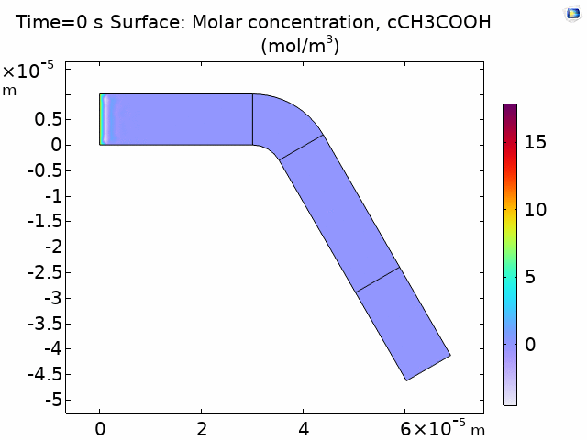

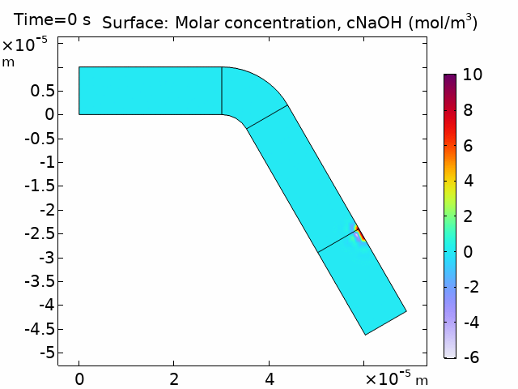

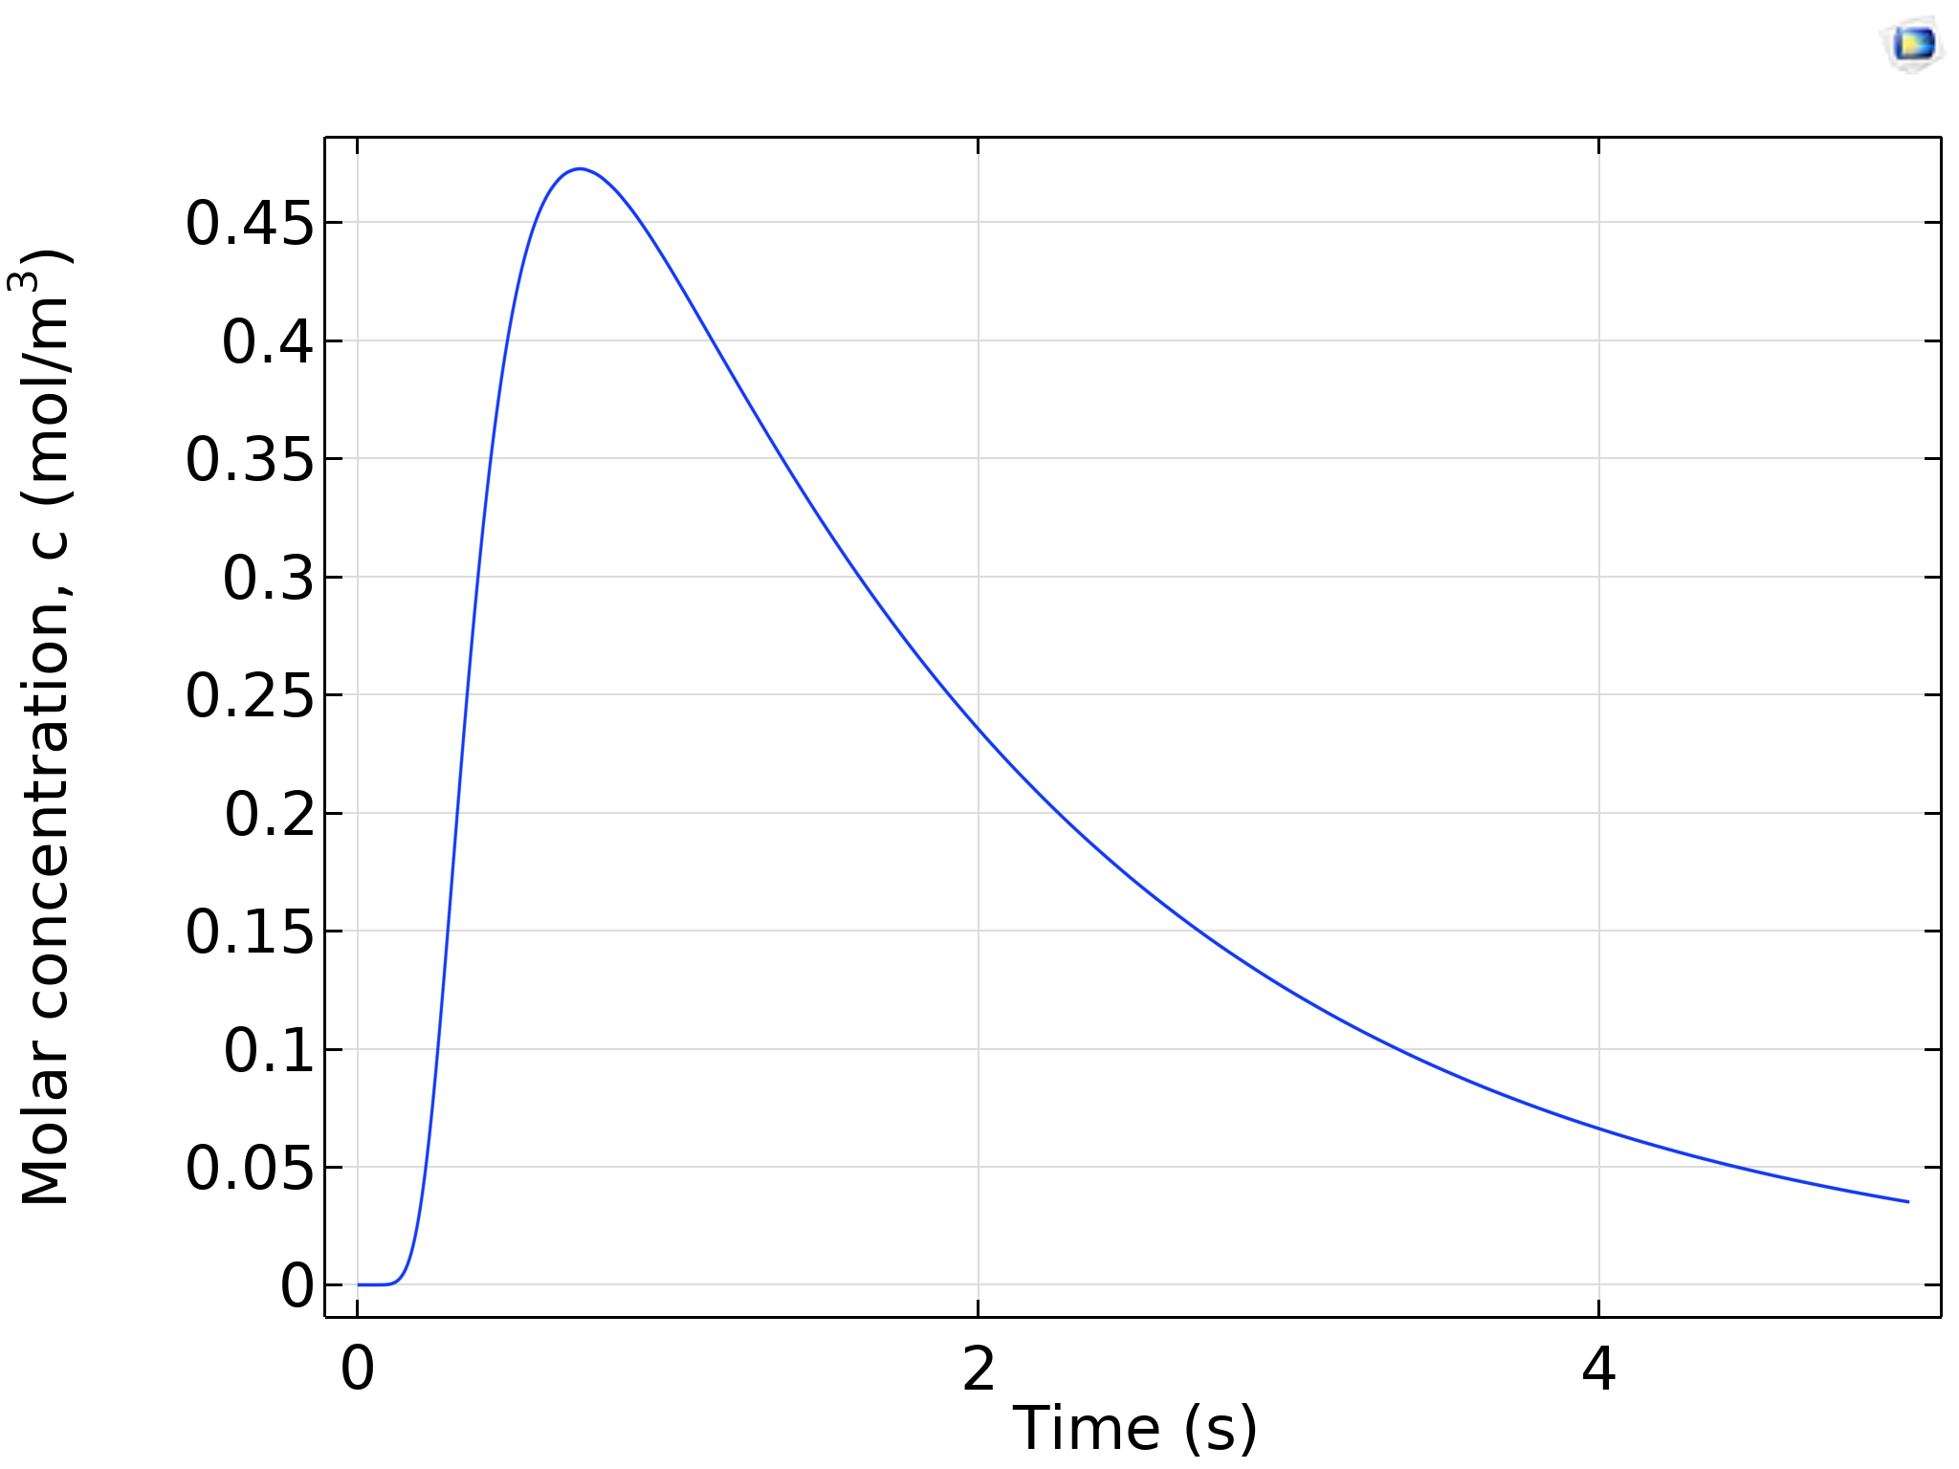
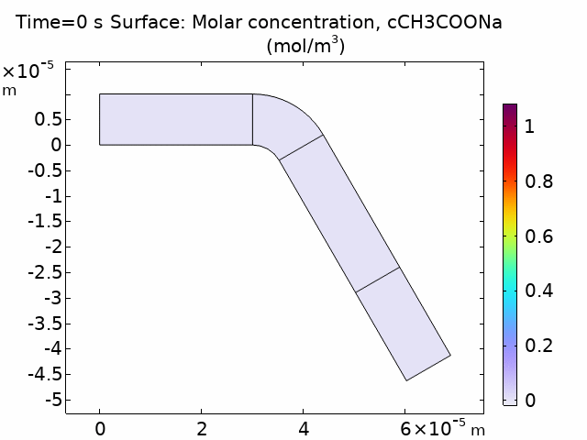
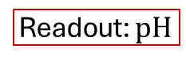
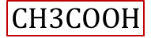
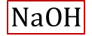
Concept
Activation
Function
$$NaOH$$
$$CH3COOH$$
$$NaOH+CH3COOH →CH3COONa+H2O$$
Readout: $pH$
4

Slide 5

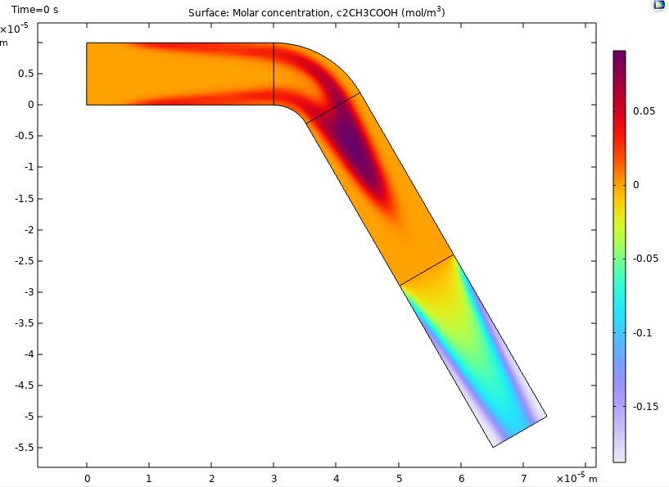
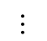
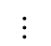
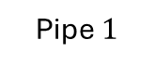
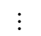
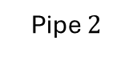
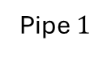
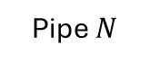
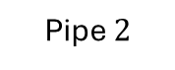
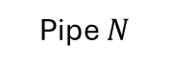
Concept
Single Neuron Scheme
Pipe $N$
$$⋯$$
Pipe $2$
Inlets
Inlet B
Pipe $1$
Outlet
Chemical Reactor
Combiner
CNN-like Scheme
Pipe $N$
$$⋯$$
$$⋯$$
Inlet B
Pipe $2$
Inlet A
Outlet
Pipe $1$
Chemical Reactor
Splitter
Combiner
5

Slide 6
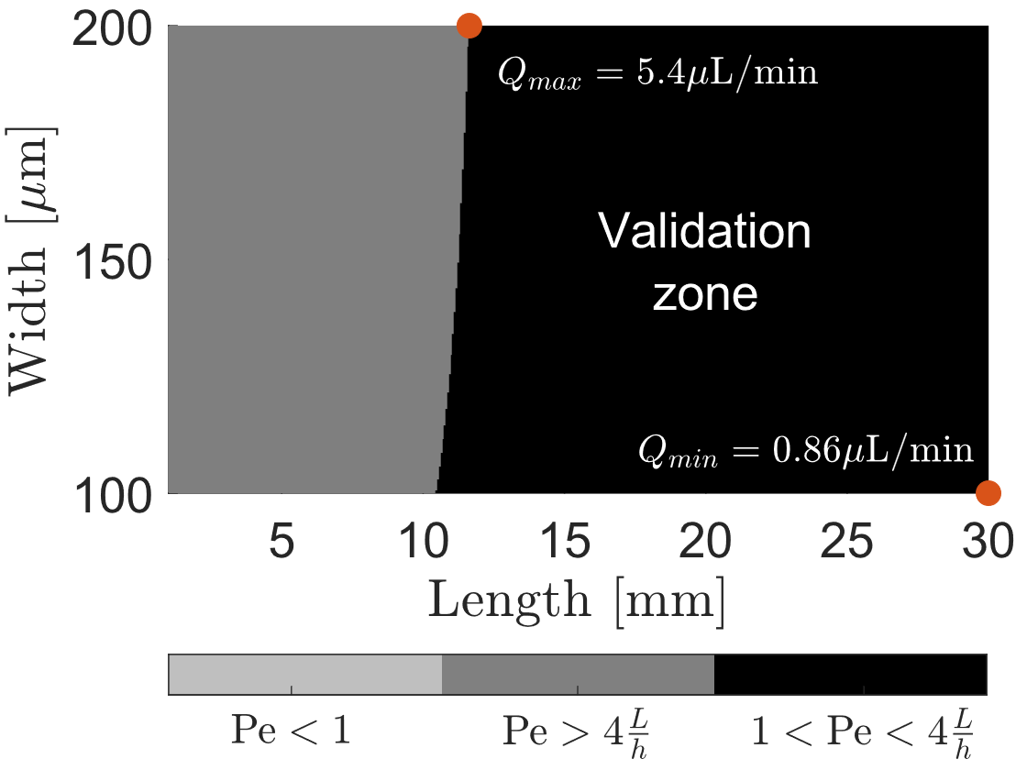
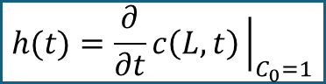
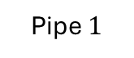
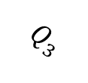
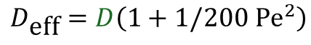
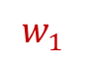
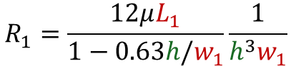












Synthesis
CNN-like Scheme
Pipe $2$
$$Q_{2}$$
Pipe $1$
Define the sampling time on Pipe 1
$$∆P$$
$$Q_{1}$$
$$L_{1}$$
$$w_{1}$$
Outlet
$$c\left(L,t\right)=\frac{1}{2}C_{0}\text{erfc}\frac{L_{1}−v_{\text{char}}t}{2\sqrt{D_{\text{eff}} t}}$$
$$\sqrt{48}≪\text{Pe}≪4\frac{L}{r}$$
$$Q_{3}$$
Pipe $3$
$$h(t)=\frac{∂}{∂t}c\left(L,t\right){\left.​\right|}_{C_{0}=1}$$
Peclet number condition
Parameter | Value
$h$ | $50 μm$
$∆P$ | $600$ Pa
$D$ Tartrazine | $4.9∙{10}^{−10} [m^{2}/s]$
$$v_{\text{char}}=\overline{v}=\frac{Q_{1}}{w_{1}h}$$
$$Q_{1}=\frac{∆P }{R_{1}}$$
$$R_{1}=\frac{12μL_{1}}{1−0.63h/w_{1}}\frac{1}{h^{3}w_{1}}$$
$$\text{Pe}=\frac{h^{2}v_{\text{char}}}{D}$$
$$D_{\text{eff}}=D\left(1+1/200 {\text{Pe}}^{2}\right)$$
6

Slide 7









Synthesis
Parameter | Value
$h$ | $50 μm$
$∆P$ | $600$ Pa
$D$ Tartrazine | $4.9∙{10}^{−10} [m^{2}/s]$
CNN-like Scheme
Pipe $2$
$$Q_{2}$$
Pipe $1$
Define the sampling time on Pipe 1
$$∆P$$
$$Q_{1}$$
$$L_{1}$$
$$w_{1}$$
Outlet
$$c\left(L,t\right)=\frac{1}{2}C_{0}\text{erfc}\frac{L_{1}−v_{\text{char}}t}{2\sqrt{D_{\text{eff}} t}}$$
$$\sqrt{48}≪\text{Pe}≪4\frac{L}{r}$$
(1)
$$Q_{3}$$
Pipe $3$
$$h(t)=\frac{∂}{∂t}c\left(L_{1},t\right){\left.​\right|}_{C_{0}=1}$$
(2)
$$v_{\text{char}}=\overline{v}=\frac{Q_{1}}{w_{1}h}$$
(3)
$$Q_{1}=\frac{∆P }{R_{1}}$$
(4)
$$R_{1}=\frac{12μL_{1}}{1−0.63h/w_{1}}\frac{1}{h^{3}w_{1}}$$
(5)
$$\text{Pe}=\frac{h^{2}v_{\text{char}}}{D}$$
(6)
7
$$D_{\text{eff}}=D\left(1+1/200 {\text{Pe}}^{2}\right)$$
(7)

Slide 8












Synthesis
CNN-like Scheme
Pipe $2$
$$Q_{2}$$
Pipe $1$
Define the sampling time on Pipe 1
$$∆P$$
$$Q_{1}$$
$$L_{1}$$
$$w_{1}$$
Outlet
$$c\left(L,t\right)=\frac{1}{2}C_{0}\text{erfc}\frac{L_{1}−v_{\text{char}}t}{2\sqrt{D_{\text{eff}} t}}$$
$$\sqrt{48}≪\text{Pe}≪4\frac{L}{r}$$
(1)
$$Q_{3}$$
Pipe $3$
$$h(t)=\frac{∂}{∂t}c\left(L_{1},t\right){\left.​\right|}_{C_{0}=1}$$
(2)
Parameter | Value
$h$ | $50 μm$
$∆P$ | $600$ Pa
$D$ Tartrazine | $4.9∙{10}^{−10} [m^{2}/s]$
$$τ=\frac{L_{1}}{v_{\text{char}}}−\frac{2D_{\text{eff}}}{v_{\text{char}}}$$
Pipe $3$
(3)
$$v_{\text{char}}=\overline{v}=\frac{Q_{1}}{w_{1}h}$$
(4)
Pipe $1$
Pipe $2$
$$Q_{1}=\frac{∆P }{R_{1}}$$
$$R_{1}=\frac{12μL_{1}}{1−0.63h/w_{1}}\frac{1}{h^{3}w_{1}}$$
(5)
(6)
$$\text{Pe}=\frac{h^{2}v_{\text{char}}}{D}$$
(7)
$$D_{\text{eff}}=D\left(1+1/200 {\text{Pe}}^{2}\right)$$
(8)
8

Slide 9

















Synthesis
CNN-like Scheme
Pipe $2$
2. Evaluate the design in COMSOL
$$Q_{2}$$
Pipe $1$
$$∆P$$
$$Q_{1}$$
$$L_{1}$$
$$w_{1}$$
Outlet
Parameter | Value
$h$ | $50 μm$
$∆P$ | $600$ Pa
$D$ Tartrazine | $4.9∙{10}^{−10} [m^{2}/s]$
$$τ=\frac{L}{v_{\text{char}}}−\frac{2D_{\text{eff}}}{v_{\text{char}}}$$
$$Q_{3}$$
(1)
Pipe $3$
9

Slide 10



Synthesis
CNN-like Scheme
Parameter | Value
$h$ | $50 μm$
$∆P$ | $600$ Pa
$D$ Tartrazine | $4.9∙{10}^{−10} [m^{2}/s]$
Pipe $2$
$$Q_{2}$$
Pipe $1$
$$∆P$$
$$Q_{1}$$
$$L_{1}$$
$$w_{1}$$
Outlet
$$Q_{3}$$
Pipe $3$
$$∆τ→∆L$$
3. Find the correction
4. Re-design in COMSOL
$$∆τ=\frac{∆L}{v_{\text{char}}}−\frac{2D_{\text{eff}}}{v_{\text{char}}}$$
(1)
10

Slide 11


Experiment 1: Design 1.1
Design 1.1
Pipe 2
Pipe 1
Purpose
Validate the synchronization of pulses through the three different pipes.
Architecture
Transmitter + CNN
Dimensions
Total size: 4.8 x 2.9 cm
Chemicals
Tartrazine and H2O
Study phase
Theoretical calculations completed
Simulation in COMSOL completed
Experimental validation is missing
Pipe 3

Slide 12

Experiment 1: Design 1.1
Purpose
Validate the synchronization of pulses through the three different pipes.
Architecture
Transmitter + CNN
Dimensions
Total size: 4.8 x 2.9 cm
Chemicals
Tartrazine and H2O
Study phase
Theoretical calculations completed
Simulation in COMSOL completed
Experimental validation is missing

Slide 13

Experiment 2: Design 2
Purpose
To validate the synchronization of pulses and expected amplitudes through the three different pipes.
Architecture
Transmitter + CNN
Dimensions
Total size: 4.8 x 2.9 cm
Chemicals
Tartrazine and H2O
Study phase
Missing the theoretical calculations of the size for the Outlet C
Missing simulation in COMSOL.

Slide 14


Experiment 3: Design 3
Purpose
To validate the chemical reaction component.
Architecture
Transmitter + Sensor
Dimensions
Total size: 5 x 2.9 cm
Chemicals
NaOH
CH3COOH
H2O
Study phase
Missing the theoretical calculations for the concentration of the chemicals.
Missing to evaluate the size of the chemical reactor.
Missing simulation in COMSOL.

Slide 15

Experiment 3: Design 3
Purpose
To validate the complete system..
Architecture
Transmitter + CNN + Sensor
Dimensions
Total size: 5 x 2.9 cm
Chemicals
NaOH
CH3COOH
H2O
Study phase
Missing the theoretical calculations for the concentration of the chemicals.
Missing simulation in COMSOL.

Slide 16




glucose
concentration
Single Neuron Scheme
Pipe $N$
$$⋯$$
Pipe $2$
Inlets
Inlet B
Pipe $1$
Outlet
Chemical Reactor
Combiner
time
serial-to-parallel
converter

Slide 17


























Analysis
$$y$$
$$y_{ro}$$
Derivative of the Step-response
$$c(x_{0},t)$$
$$r_{out}$$
$$c(x_{1},t)$$
$$r_{in}$$
$$c(x_{2},t)$$
$$x$$
(1)
$$l$$
$$φ$$
$$c_{r}(x_{ro},t)$$
(2)
O
$$x_{ro}$$
$${\overline{c}}_{r}(x_{ro},y_{ro},t)$$
(3)
$$y$$
$$c(x_{0},t)$$
$$c(x_{1},t)$$
$$c(x_{2},t)$$
$$l$$
(4)
(5)
$$x$$
(6)
17

Slide 18














Analysis
$$y$$
$$y_{ro}$$
$$r_{in}$$
$$r_{out}$$
$$c(x_{1},t)$$
$$c(x_{2},t)$$
$$c(x_{0},t)$$
$$x$$
$$l$$
Derivative of the Step-response
$$φ$$
$$c_{r}(x_{ro},t)$$
O
(1)
$$x_{ro}$$
$$x_{ro}$$
(2)
18

Slide 19








Analysis
$$y$$
$$y_{ro}$$
$$r_{in}$$
$$r_{out}$$
$$c(x_{1},t)$$
$$c(x_{2},t)$$
Derivative of the Step-response
$$x$$
$$c(x_{0},t)$$
$$l$$
$$φ$$
$$c_{r}(x_{ro},t)$$
(1)
O
$$x_{ro}$$
$φ=\frac{π}{3}$ $r=20$ μm
$L=3$ mm $r=20$ μm
$L=3$ mm $φ=\frac{π}{3}$
19

Slide 20







Application
CNN-like Scheme
Pipe $N$
$$⋯$$
500 μm to 1 mm
Inlet B
$$⋯$$
Inlet C
Communication Channel
Pipe $2$
Inlet A
Outlet
Pipe $1$
Outlet
Definitions
Chemical Element.
Fluid element.
Pressure.
Size of pipes.
Design of the electronic components
[1] M. M. Albay, E. Akyol, F. Mirlou, L. Beker, and M. Kuscu, “Low-cost Microfluidic Testbed for Molecular Communications with Integrated Hydrodynamic Gating and Screen-printed Sensors,” Jan. 31, 2025, arXiv: arXiv:2501.19341. doi: 10.48550/arXiv.2501.19341.
20

Slide 21











Application
$3×5$ cm
CNN-like Scheme
Pipe $3$
Transmitter
1mm to 4 mm
Inlet B
$$⋯$$
Pipe $2$
Communication Channel
Inlet C
Inlet A
Outlet B
Pipe $1$
Outlet A
Time to fill-in
$∆t={V_{L}}/{Q_{min}}$
$∆t= {2πr^{2}×{heigth}_{max}}/{Q_{min}}$
Flow max
$Q=0.5−7$ μl/min
Height
$\text{10−}\text{50}$ μm
Width: minimum
$\text{5}\text{0}\text{−500}$ μm
NaOH
$$r=50 \text{μ}\text{m}$$ | $$Q=1.89 \text{μ}\text{l}\text{/}\text{min}$$ | $T_{b}=5$ s | $∆t=635$ ms | $≈12\%$
$$r=100 \text{μ}\text{m}$$ | $Q=6.9$ μl/min | $T_{b}=4$ s | $∆t=410$ ms | $≈10\%$
$$r=250 \text{μ}\text{m}$$ | $Q=2.4$ μl/min | $T_{b}=5$ s | $∆t=1.17$s | $≈30\%$
21

Slide 22





Application
$3×5$ cm
CNN-like Scheme
Pipe $3$
Transmitter
500 μm to 1 mm
Inlet B
$$⋯$$
Pipe $2$
Communication Channel
Inlet C
Inlet A
Outlet B
Pipe $1$
Outlet A
22

Slide 23






















Design 1.0
$$P_{u32}$$
$$P_{b32}$$
$$P_{u22}$$
Pipe $3$
$$⋯$$
$$P_{u31}$$
$$P_{b22}$$
Pipe $2$
$$P_{u0}$$
$$P_{u33}$$
$$P_{u11}$$
$$P_{b31}$$
$$P_{u21}$$
$$P_{b21}$$
$$P_{b23}$$
$$P_{u23}$$
$$P_{b33}$$
Pipe $1$
$$P_{b0}$$
$$P_{b12}$$
$$P_{b13}$$
$$P_{b11}$$
23

Slide 24

Design 1.0
24

Slide 25




Design 2
Pipe $3$
Inlet B
$$⋯$$
Pipe $2$
Pipe $1$
Inlet A
Outlet B
Outlet A
Outlet C
25

Slide 26
Design 3
Chemical Reactor
Inlet B
Inlet C
Inlet A
Outlet B
Outlet A
26

Slide 27




Design 4
CNN-like Scheme
Pipe $3$
Transmitter
Communication Channel
Chemical Reactor
Inlet B
$$⋯$$
Pipe $2$
Inlet C
Pipe $1$
Inlet A
Outlet B
Outlet A
Outlet C
27

Slide 28

Application
Pipe $3$
Inlet B
$$⋯$$
Pipe $2$
Inlet C
Inlet A
Outlet B
Pipe $1$
Outlet A
28

Slide 29
Application
CNN-like Scheme
Pipe $N$
$$⋯$$
500 μm to 1 mm
Inlet B
$$⋯$$
Inlet C
Communication Channel
Pipe $2$
Inlet A
Outlet
Pipe $1$
Outlet
29

Slide 30
Application
$3×5$ cm
CNN-like Scheme
Pipe $3$
Transmitter
500 μm to 1 mm
Inlet B
$$⋯$$
Pipe $2$
Communication Channel
Inlet C
Inlet A
Outlet B
Pipe $1$
Outlet A
30

Slide 31

















Synthesis
Pipe $2$
Pipe $3$
Pipe $3$
Pipe $1$
Inlet B
$$⋯$$
Pipe $2$
Inlet C
Inlet A
Outlet B
Pipe $1$
Outlet A
NaOH
Radius: $r∈50−70$ μm
Pipe $3$
Pipe $2$
Pipe $1$
Pipe $2$
Pipe $3$
Pipe $1$
31

Slide 32








Synthesis
Pipe $2$
Pipe $3$
Pipe $3$
Pipe $1$
Inlet B
$$⋯$$
Pipe $2$
Inlet C
Inlet A
Outlet B
Pipe $1$
Outlet A
NaOH
Radius: $r∈50−70$ μm
Pipe $1$
Pipe $2, L_{1}=16.5$ mm
Pipe $3, L_{1}=16.5 \text{mm}$
32

Slide 33



Synthesis
Pipe $2$
Pipe $3$
Pipe $3$
Pipe $1$
Inlet B
$$⋯$$
Pipe $2$
Inlet C
Inlet A
Outlet B
Pipe $1$
Outlet A
NaOH
Radius: $r∈120−150$ μm
Pipe $1$
Pipe $2$
Pipe $2$
Pipe $3$
Pipe $1$
Pipe $3$
33

Slide 34




Synthesis
Pipe $2$
Pipe $3$
Pipe $3$
Pipe $1$
Inlet B
$$⋯$$
Pipe $2$
Inlet C
Inlet A
Outlet B
Pipe $1$
Outlet A
NaOH
Radius: $r∈100−120$ μm
Pipe $1$
Pipe $2, L_{1}=16.5$ mm
Pipe $3, L_{1}=16.5 \text{mm}$
34

Slide 35














Synthesis
Pipe $2$
Pipe $3$
Pipe $2$
Pipe $1$
Inlet B
$$⋯$$
Pipe $2$
Inlet C
Inlet A
Outlet B
Pipe $1$
Outlet A
NaOH
Radius: $r∈250−270$ μm
Pipe $2$
Pipe $3$
Pipe $2$
Pipe $3$
Pipe $1$
Pipe $1$
35

Slide 36







Synthesis
Pipe $2$
Pipe $3$
Pipe $2$
Pipe $1$
Inlet B
$$⋯$$
Pipe $2$
Inlet C
Inlet A
Outlet B
Pipe $1$
Outlet A
NaOH
Radius: $r∈250−270$ μm
36

Slide 37







Synthesis
Pipe $2$
Pipe $3$
Pipe $2$
Pipe $1$
Inlet B
$$⋯$$
Pipe $2$
Inlet C
Inlet A
Outlet B
Pipe $1$
Outlet A
NaOH
Radius: $r∈250−270$ μm
Pipe $1$
Pipe $2, L_{1}=28.3$ mm
Pipe $3, L_{1}=28.3 \text{mm}$
37

Slide 38













Synthesis
Pipe $3$
Inlet B
$$⋯$$
Pipe $2$
Inlet A
Outlet B
Pipe $1$
Outlet A
Tartrazine
Radius: $r∈250−270$ μm
Pipe $1$
Pipe $2$
Pipe $3$
Pipe $3$
Pipe $2$
Pipe $1$
38

Slide 39






Synthesis
Pipe $2$
Pipe $3$
Pipe $2$
Pipe $1$
Inlet B
$$⋯$$
Pipe $2$
Inlet A
Outlet B
Pipe $1$
Outlet A
Tartrazine
Radius: $r∈100−120$ μm
Pipe $1$
Pipe $2, L_{1}=26.6$ mm
Pipe $3, L_{1}=26.6 \text{mm}$
39

Slide 40









Synthesis
CNN-like Scheme
Pipe $N$
$$⋯$$
$$⋯$$
Inlet B
Pipe $2$
Inlet A
Outlet
Pipe $1$
Chemical Reactor
Splitter
Combiner
Design constraints
(1)
(2)
(3)
40

Slide 41







Synthesis
CNN-like Scheme
Pipe $N$
$$⋯$$
$$⋯$$
Inlet B
Pipe $2$
Inlet A
Outlet
Pipe $1$
Chemical Reactor
Splitter
Combiner
41

Slide 42


Synthesis
CNN-like Scheme
Design constraints
Pipe $N$
(1)
$$⋯$$
$$⋯$$
Inlet B
Pipe $2$
(2)
Inlet A
Outlet
Pipe $1$
Chemical Reactor
Splitter
Combiner
(3)
42

Slide 43


Synthesis
CNN-like Scheme
Design constraints
Pipe $N$
(1)
$$⋯$$
$$⋯$$
Inlet B
Pipe $2$
(2)
Inlet A
Outlet
Pipe $1$
Chemical Reactor
Splitter
Combiner
(3)
43

Slide 44

Synthesis
CNN-like Scheme
Pipe $N$
$$NaOH+CH3COOH →CH3COONa+H2O$$
$$⋯$$
$$⋯$$
Inlet B
Pipe $2$
Inlet A
Outlet
Pipe $1$
Chemical Reactor
Splitter
Combiner
44

Slide 45


Bio-Computing
Digital Computing
Chemical Reaction Networks
DSP
Microfluidic Chips
45

Slide 46





Linear Component: $ω_{i}∙x_{i}$
$$ω_{1}$$
$$ω_{2}$$
46

Slide 47

Bio-Computing
Analog Computing
Wet-Neuromorphic Computing
Chemical Reaction Networks
Compartment Based
Models
Reservoir Computing
J. Perera et al., “Wet-Neuromorphic Computing: A New Paradigm for Biological Artificial Intelligence,” IEEE Intelligent Systems, pp. 1–7, 2025. DOI: 10.1109/mis.2025.3555551.

Slide 48

Bio-Computing
Analog Computing
Wet-Neuromorphic Computing
Chemical Reaction Networks
Compartment Based
Models
Reservoir Computing
J. Perera et al., “Wet-Neuromorphic Computing: A New Paradigm for Biological Artificial Intelligence,” IEEE Intelligent Systems, pp. 1–7, 2025. DOI: 10.1109/mis.2025.3555551.

Slide 49


Bio-Computing
Analog Computing
Wet-Neuromorphic Computing
Chemical Reaction Networks
Compartment Based
Models
Reservoir Computing
J. Perera et al., “Wet-Neuromorphic Computing: A New Paradigm for Biological Artificial Intelligence,” IEEE Intelligent Systems, pp. 1–7, 2025. DOI: 10.1109/mis.2025.3555551.

Slide 50

Bio-Computing
[1] S. Balasubramaniam, S. Somathilaka, S. Sun, A. Ratwatte, and M. Pierobon, “Realizing Molecular Machine Learning Through Communications for Biological AI,” IEEE Nanotechnology Magazine, vol. 17, no. 3, pp. 10–20, Jun. 2023, doi: 10.1109/MNANO.2023.3262099.

Slide 51

Bio-Computing
Digital Computing
Chemical Reaction Networks
DSP
Microfluidic Chips
Analog Computing
Wet-Neuromorphic Computing
Chemical Reaction Networks
Compartment Based Models
Reservoir Computing
$\sim 300$ learnable parameters

Slide 52

Datasets
52

Slide 53
Communicating Smartly at the Nanoscale - Neural Networks Developments in Molecular Communication
Jorge Torres Gómez | Telecommunication Networks

Slide 54
nanoAI Lab: A new research group
Jorge Torres Gómez | Telecommunication Networks

Slide 55



Research groups in our Network
General Purpose AI for IoBNT Applications
Micro-fluidic circuits
Werner Haselmayr
Ozgur Baris Akan
H. Birkan Yilmaz
Functionalized Graphene
Ozgur Baris Akan

Slide 56





Grant programs: National
Discovery Grants
Address higher-risk (higher reward) topics.
Discovery Horizons/Alliance Society
Investigator-initiated individual and team projects.
Interdisciplinary research.
Exploration
Competition-based
Interdisciplinary research.
Promote relevant collaborations across disciplines, professions, and sectors.

Slide 57



Grant programs: International
International
Competition based
Four years funding
Funding for one year to initiate international research collaborations
International Partners:
Turkey (Koc Uni., Bogazici Uni.)
Germany (TU Berlin, TU Dresden, TU Darmstadt, Erlangen)
Norway (Oslo University Hospital)
Sweeden (Uppsala University)
Spain (Polytechnic University of Barcelona)
Italy (University of Milano)
US (Northeastern University, Michigan University, Nebraska)
Join and lead consortium projects among 3 countries at least (EU+Canada)

Slide 58


NanoAI Lab: MOU Network
Deciphering Gene Regulation in Bacteria
Lourdes Pena-Castillo
Computer Science
https://www.cs.mun.ca/~lourdes/public/index.html
Signaling Mechanisms in Cell Survival and Cell Growth
Dr. Brian E. Staveley, Ph.D.
Department of Biology
https://www.mun.ca/biology/bstaveley/
Peptide-Induced Reorganization of Lipid Assemblies
M. R. Morrow
Department of Physics
https://www.physics.mun.ca/~mmorrow/
Hierarchical Materials
Erika Merschrod
Department of Chemistry
https://www.merschrod.group/team.html
Electronic sensor platform

Slide 59
Understanding SeMeCo: Yeast Metabolic Teamwork
Falko Dressler | Telecommunication Networks

